Slide 1
Presidential Campaigns

Slide 2
Agenda
Question
Context
Data Preprocessing
Modeling
Conclusions
Further Research
Appendix

Slide 3
Question
What states should presidential campaigns spend their money?
Notes:
Should depend on propensity to switch, which should be determined by how close a particular state was to 50/50, and on number of electoral votes, how valuable a state is.

Slide 4
Context
Candidate has to win 270 of 538 electoral votes
Two to each state
Three to DC
Balance allocated among states by population
Every state except Nebraska and Maine is “winner-take-all”

Slide 5
Data Preprocessing
Issue
Solution
Limited data
P>>N
Fractional Shares
Interested in ‘swinginess’
Limit analysis to 2008 and 2012
Remove duplicates, PLSR
Logit Transform
Target=a-a²
Notes:
PLSR—supervised feature extraction
Swinginess—how close it is to 50/50 split

Slide 6
Modeling Considerations
Electoral votes don’t change; swinginess does
Model swinginess first
Then model effects of swinginess and electoral votes on ad spend.
Use smoothing factors to handle logarithms.

Slide 7
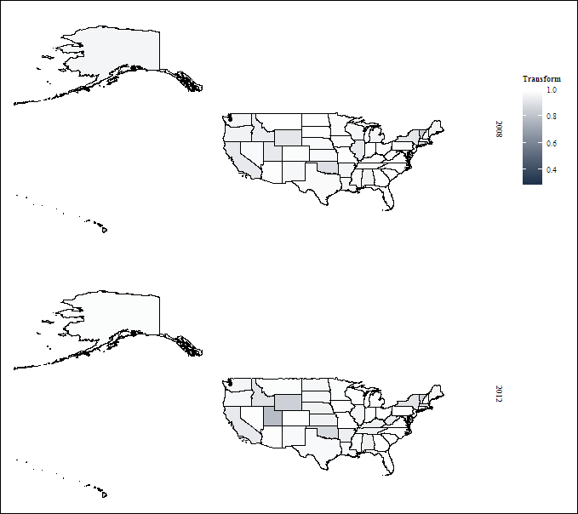
Past Behavior (RMSE=, AIC=) *****ADD MY GRAPH********

Slide 8
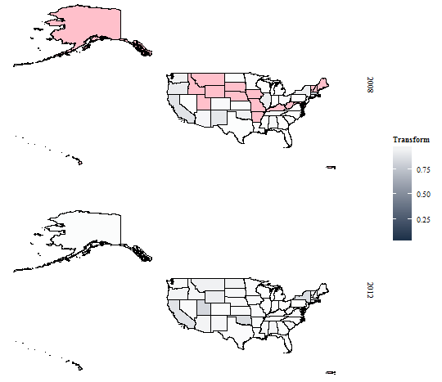
Demographics (RMSE=, AIC=)

Slide 9
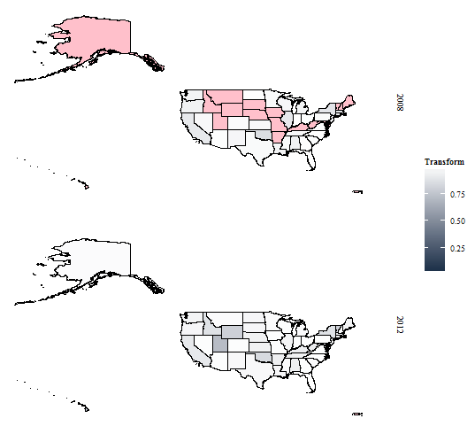
Attitudes (RMSE=, AIC=)

Slide 10
Everything (RMSE=, AIC=) **DOUBLE CHECK MY GRAPH**

Slide 11
Ad Spending?
Suitable model for swinginess
Correlation against swinginess: 62%
Correlation against electoral votes: 31%
Correlation against interaction: 99%
Clearly, both matter
Notes:
Spearman correlation: measuring ranks—robust to outliers such as Ohio and Florida
Interaction between transform (swinginess) and electoral votes

Slide 13
Conclusions
Spend in big swingy states
Find swingy states using demographics
Behavior isn’t good enough
Attitude is expensive and barely better (Census data is free)

Slide 14
Further Research
Examine at county level
Examine for midterm elections

